Slide 1
IoT Setup
Date: 10 -02 -2021

Slide 2
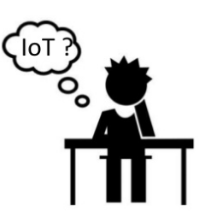
IoT Setup
WHAT IS
INTERNET
OF THINGS
(IoT)
And
Uses of
IoT in
BANKING

Slide 3
IoT Setup
What is IoT .. ?

Slide 4
IoT Setup
The IoT concept entails bringing together all things in the world and connecting them to the internet. In other words, it means expanding the capability of the internet beyond smartphones and computers to many other things, environment and processes.
IoT technologies provide better insight into business and allow organizations to become in better control of their businesses and things around them.

Slide 5
IoT Setup
Uses of Internet of Things in Banking .. ?

Slide 6










IoT Setup
Internet of Things For Banking
Loan Details
Collaterals
ATM
Online Payments
Vehicle Loans
Documents
Customer
Track
Depreclaration
Loans
Browsers
Mortgage Loans
Agains Property
Impairments

Slide 7
IoT Setup
IoT use cases for Banking System

Slide 8
IoT Setup
Fintech Wearables
Pay From Anywhere
Fraud Protection
Smart Bank Branches and ATMs
Improved Spending Visibility

Slide 9
IoT Setup
IoT Architecture

Slide 10
IoT Setup
Display Panel
Power Supply
HMI
Programmable Logic Controller
Raspberrypi
RPi
PLC
Humidity & Temperature Transmitter
PID Display
RH
TEMP
RH & TEMP
Transmitter
Proximeter
Sensors
S 1
S 1
PID 1
PID 2
Controllers

Slide 11
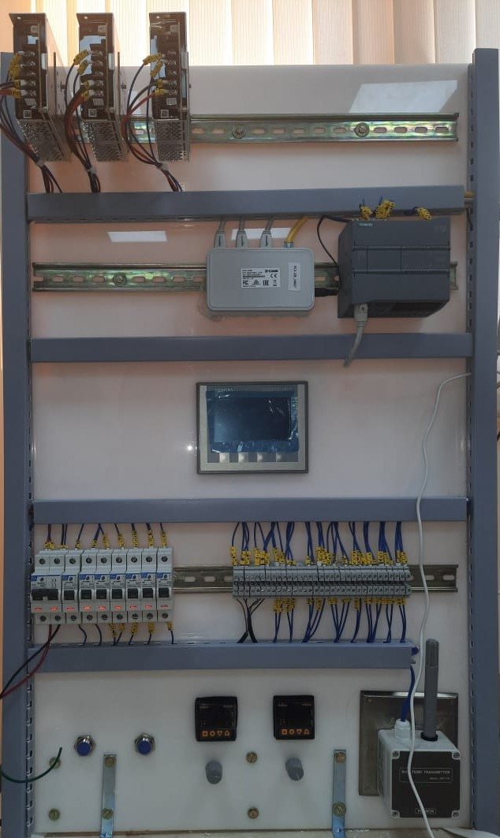
IoT Setup

Slide 12
IoT Setup
Thank You

